Slide 1
Applications in Optical Coherence Tomography and Advances into an Photonic Integrated Device
Bernardo de B C Kyotoku
Anderson S L Gomes
24 de março de 2011

Slide 2
Outline
Part I: Optical coherence tomography (OCT)
Introduction to OCT
3 applications.
2 systems
Part II: Integrated spectrometers
Motivation
Literature review
Rowland spectrometer
Ring enhanced spectromter

Slide 3
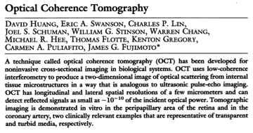
Introduction
1991

Slide 4
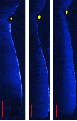
What is OCT?
Notes:
OCT é basicamente uma técnica de
alvo modifica a luz que retorna, e analisando essa luz é possivel descobrir a forma de dentro do objeto.
Mais especificamente, é possivel descobrir qual é a estrutura interna que o alvo precisa ter para modificar a luz retornante da forma medida.
Como OCT realiza isso?

Slide 5
What is OCT?
Notes:
Para isso temos que olha direito o interno do OCT

Slide 6
What is OCT?
Notes:
OCT é basicamente uma técnica de

Slide 7
What is OCT?
source
Notes:
OCT é basicamente uma técnica de

Slide 8
What is OCT?
source
Notes:
OCT é basicamente uma técnica de

Slide 9
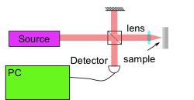
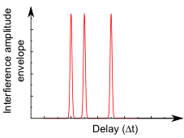
OCT basics
Notes:
Por conta da diferenca da distancia que a luz caminha nos dois bracos
Batimento da intensidade da luz de saida no dominio da frequencia, cuja frequencia de batimento é maior quanto mais profundo a luz se aprofunda na amostra.

Slide 11
What is OCT?
Notes:
OCT é basicamente uma técnica de

Slide 12
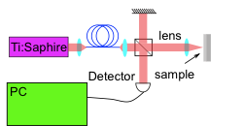
Source

Slide 13
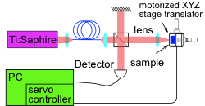
Scanning sample

Slide 14
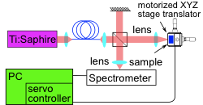
Spectrometer

Slide 15
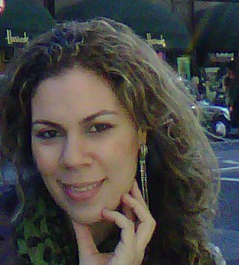
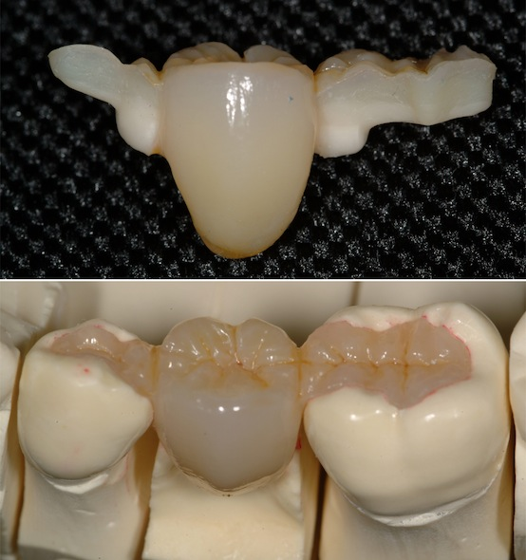
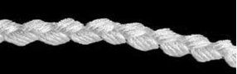
Fiber reinforced composites
Ana Karlla Bráz
Composite dental bridge

Slide 16
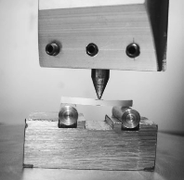
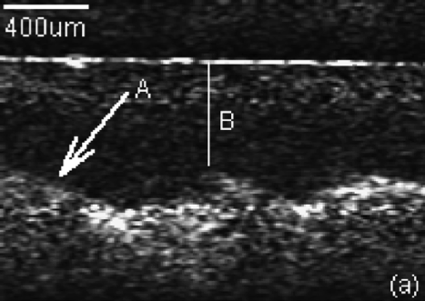
Fiber reinforced composites
Force
sample
Notes:
Karlla

Slide 17
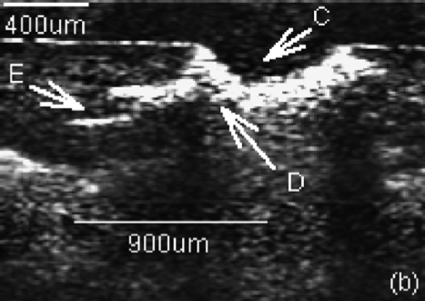
Dental Material 25.1 (2009), pp. 74–9.
Notes:
Publicado em

Slide 18
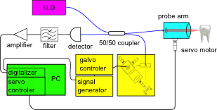
Fourier delay line

Slide 19
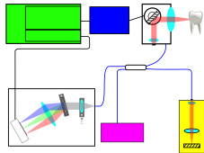
Improvements
Beam
scanner
Signal
generator
Galvo
contr.
PC
Video card
Spectrometer
Ref.
SLD

Slide 20
 | 0CT800v1 | OCT800v2 | OCT1300
Depth scan length | 0.5 mm | 4 mm | > 10 mm
Imaging time | 50 sec | >1 sec | 50 sec
Wavelength | 800 nm | 845 nm | 1280 nm
Source | Ti:Sapphire | SLD | SLD

Slide 21
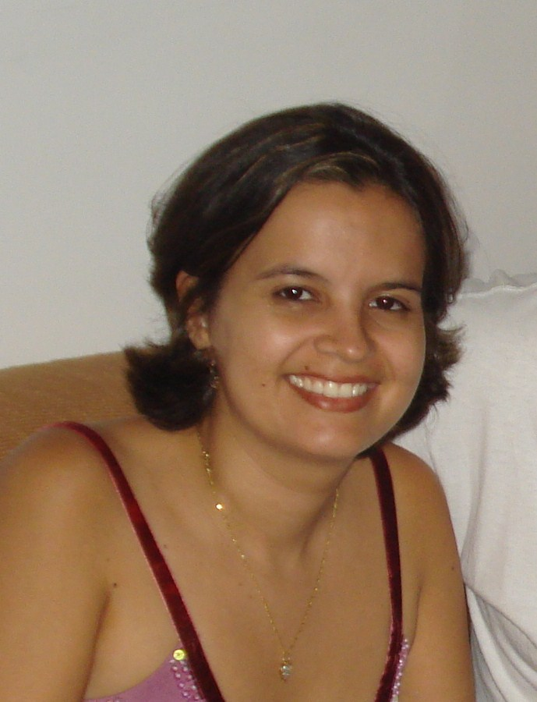
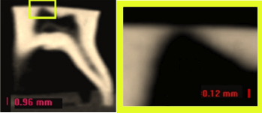
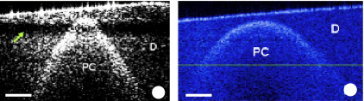
Imaging of Remaining Dentin and Pulp Chamber
Déborah Fonseca
Journal of Biomedical Optics, 14 (2009), p. 024009
Notes:
Construiu dois outros sistemas
-1300
800 mais rapido pq tinha um espectrometer mais rapido
Trabalho feito pela debora

Slide 22
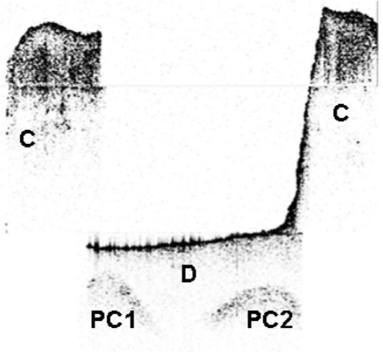
Notes:
Motrar onde foi publicado

Slide 23

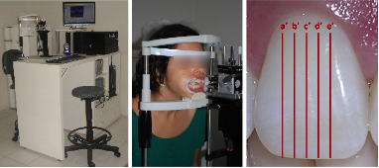
Clinical evaluation of dental restorations integrity
Cláudia Mota
Notes:
Claudia

Slide 24
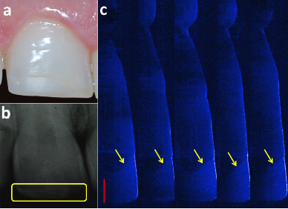

Slide 25
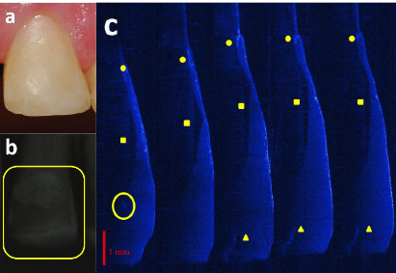

Slide 26
Summary
Fiber reinforced composite analysis using OCT
Two new OCT system were built.
A 1300 nm with Fourier Delay Line.
A 800 nm spectral radar.
Remaining dentin layer thickness measurement.
In vivo analysis of dental restorations.

Slide 27
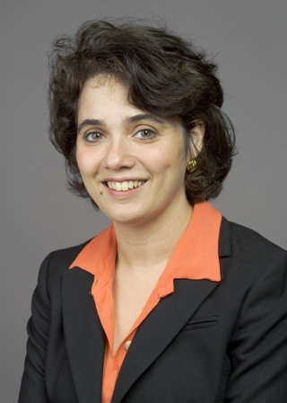
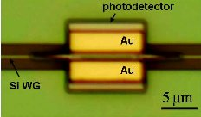
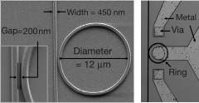
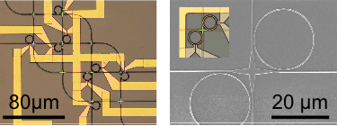
Part II: Integrated Photonics
Michal Lipson
Chen, Optics Express
Xu, Nature
Sherwood-Droz, Optics Express

Slide 28
Integrated OCT
Beam scanner
Signal
generator
Galvo
controler
PC
Video card
Optical coupler
Spectrometer
Reference
SLD

Slide 29
Spectrometer specifications
 | Best available | Required
Resolution | 0.2 nm | 0.05 nm
Operation range | 10 nm | 100 nm

Slide 30
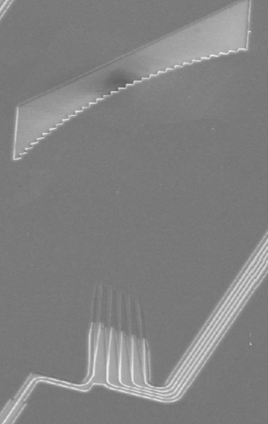
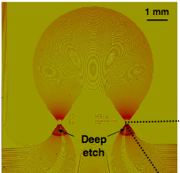
Previous devices
3
20 nm resolution
0.2 nm resolution
11 mm diagonal
0.3 mm diagonal
Roel Baets
Pavel Cheben
Ghent University - Belgium
National Research Council of Canada
Notes:
Previous work on this have been done. Employing either Arrayed Waveguide Gratings or Rowland configuration as the design. But devices as still either too big cheben’s one being 8x8 mmˆ2 although having the very high resolution of 0.2 nm or they are small like brouckeart’s device which is 0.28x0.15
a resolution too low, Brouckaert’s been 20 nm. But not both.

Slide 31
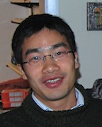
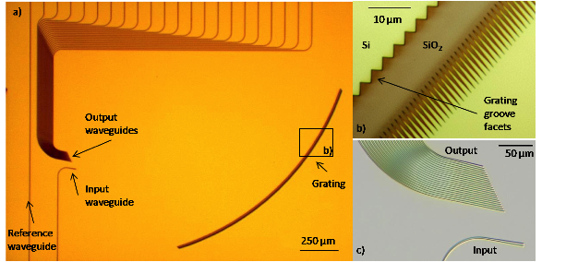
First spectrometer
Long Chen

Slide 32
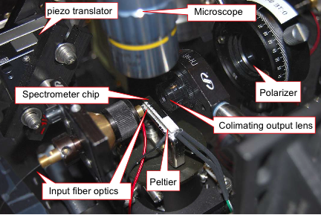

Slide 33
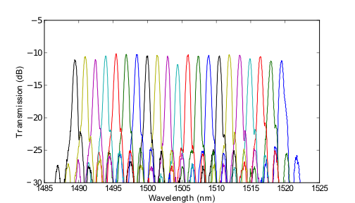
Results
Broad Band 1 nm Channel Spacing
Silicon-on-Insulator Wavelength Division Multiplexer
CLEO 2009

Slide 34
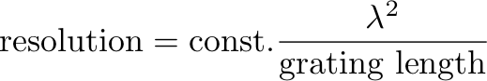

Slide 35
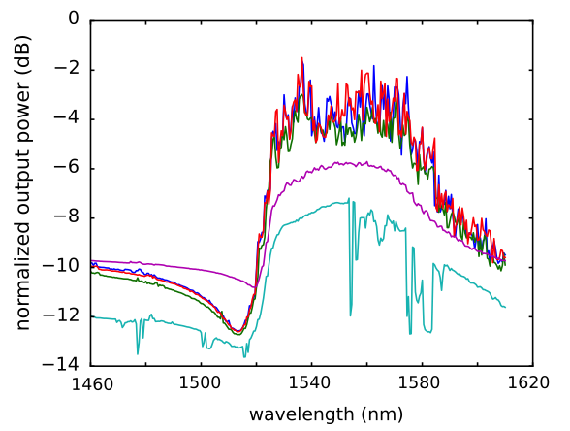

Slide 36
What do we do?

Slide 37
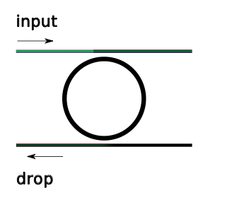
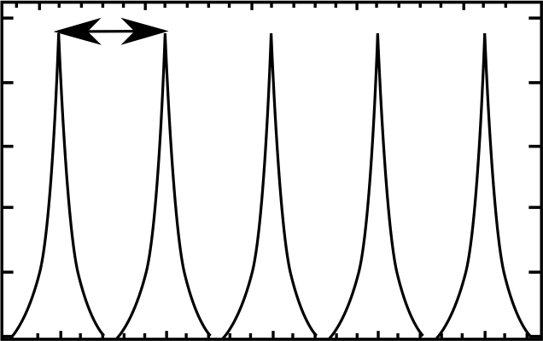
Wavelength Filtering
5
Optical Cavities
FSR
Transmission
Wavelength
Notes:
The ring resonator is very good at transmitting light from the inut to the drop only light that is resonatong in the ring. But the utput is only in one waveguide. The diffraction then takes this light from each different resnant and route it to each different waveguides.

Slide 38
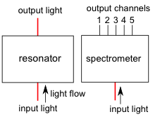
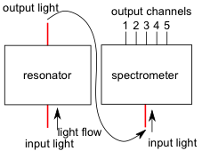
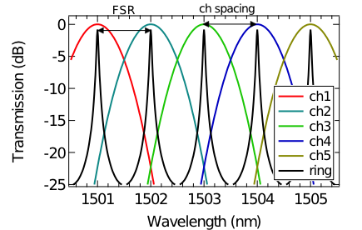
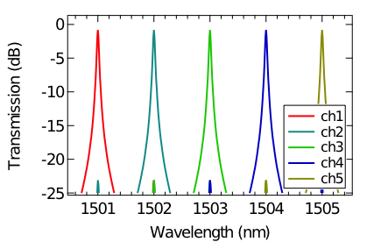
Ring Enhanced Spectrometer

Slide 39
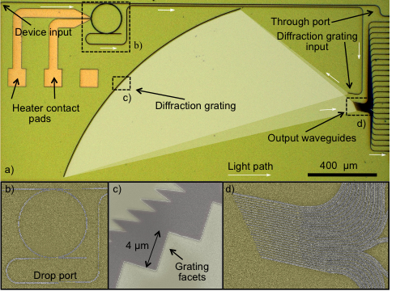
Fabricated Device
6
Notes:
This s the actual device. On the left we see a ring. The cemter is the diffraction grating. Over here we see all the outpu waveguides.
Here we have an input waveguide, light is guided through it, passing nearby the ring resonator, light is coupled into the ring resonator the evanescent waves and the wavelength that resonantes in the ring are then routed to the drop waveguide below also through evanescent waves. From there light is then guided until the diffraction grating input waveguide which then ilumantes the diffraction grating. The diffraction grating is made out of 350 grooves of 4 um, light is then diffracted and each different wavelength focus at a different position, here, where we placed an arraw of waveguide, each resonant wavelength is focus to one of the waveguides of the array and then guide to the edge of the chip. To tune the resonances we put the nichrome heaters here.
Show the waveguides
Smothen the background
Red arrows
animation

Slide 40
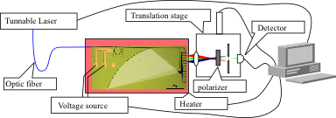
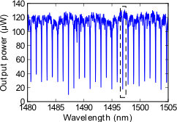
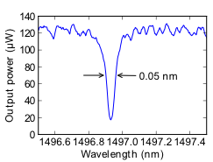
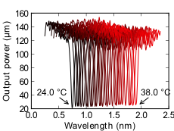
Testing
Notes:
Saida de rejeito
Saida filtrada
Faixa espectral livre

Slide 41
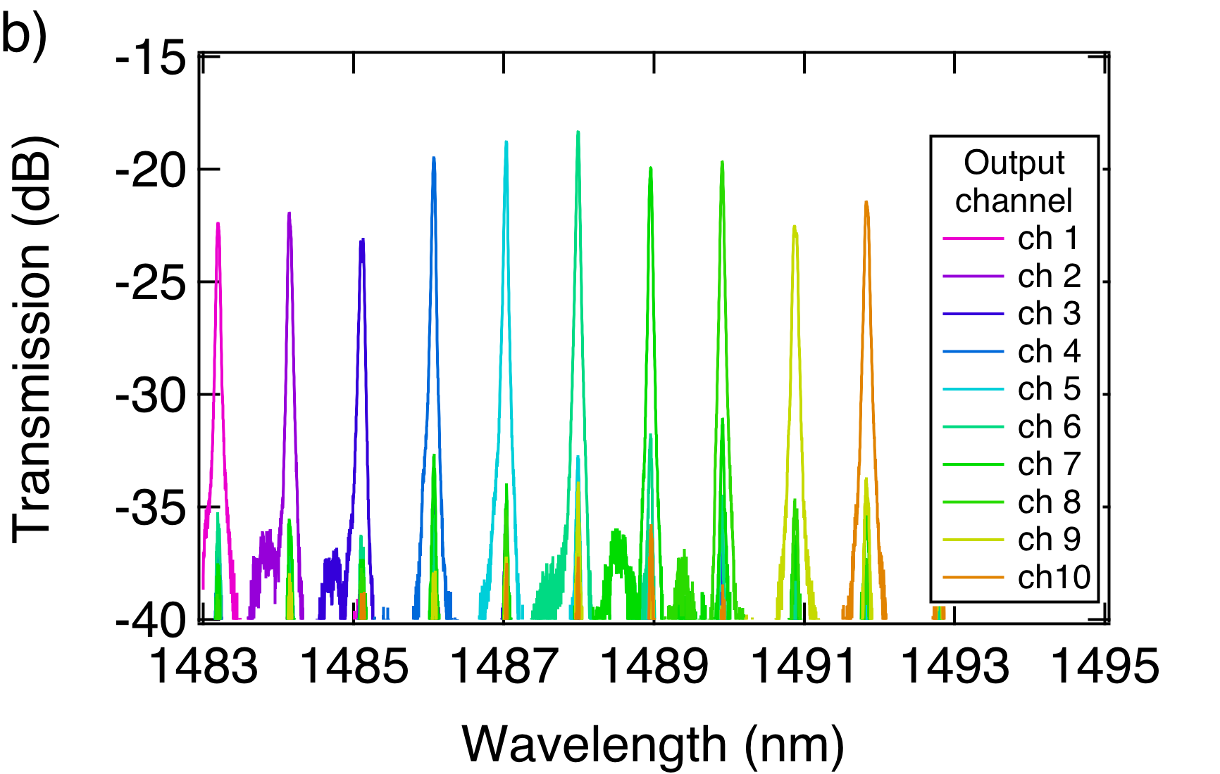
Transmission Spectrum using tunable laser
7
1 nm
0.05 nm
Notes:
**put rrows in the figure***And here it the transmission spectrum for 10 different channel, channel spacing is 1 nm with 0.05 nm FWHM. And at least 10 dB ER between the peak and the leakage from the neighboring resonances.
Now we need to increase the channel density, to fill out the gaps. There are two ways to do this

Slide 42
How to increase the channel density?
8

Slide 43
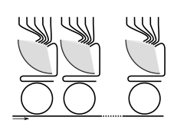
Increasing channel density
9
Cascading devices
Device 1
Device 2
Device n
Input
Notes:
The first one is connecting several devices in tandem. The first ring will just route the resonant wavelengths to the spectrometer. The non resonant light pass straight to the through waveguide to a second ring resonator which should route the whose resonance should be shifted by a fraction of the channel spacing.

Slide 44
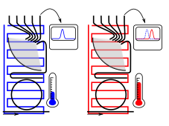
Increasing channel density
10
Changing temperature
T=30.0°C
T=31.2°C

Slide 45
Transmission Spectrum using tunable laser
11
1 nm
0.05 nm
Notes:
**put rrows in the figure***And here it the transmission spectrum for 10 different channel, channel spacing is 1 nm with 0.05 nm FWHM. And at least 10 dB ER between the peak and the leakage from the neighboring resonances.
Now we need to increase the channel density, to fill out the gaps. There are two ways to do this

Slide 47
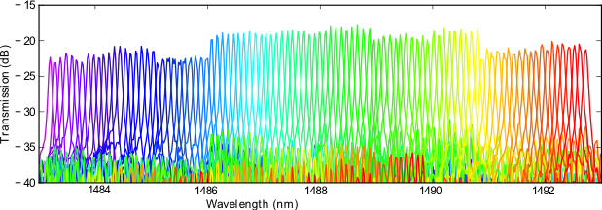
High Density Measurements
12
Reference | Diagonal (mm) | Resolution (nm) | FSR (nm) | Crosstalk (dB) | Diagonal X Resolution
Brouckaert | 0.3 | 20 | 150 | -30 | 6
Cheben | 11 | 0.2 | 10 | -10 | 2.2
Horst | 0.3 | 3.2 | 75 | -19 | 0.9
Current work | 1.4 | 0.1 | 115 | -8 | 0.14
Optics Express 2010
Notes:
But you really care is the product of the footprint and reolution **show another columng**. This device enables unorecedent resolution with a very small footrpint

Slide 48
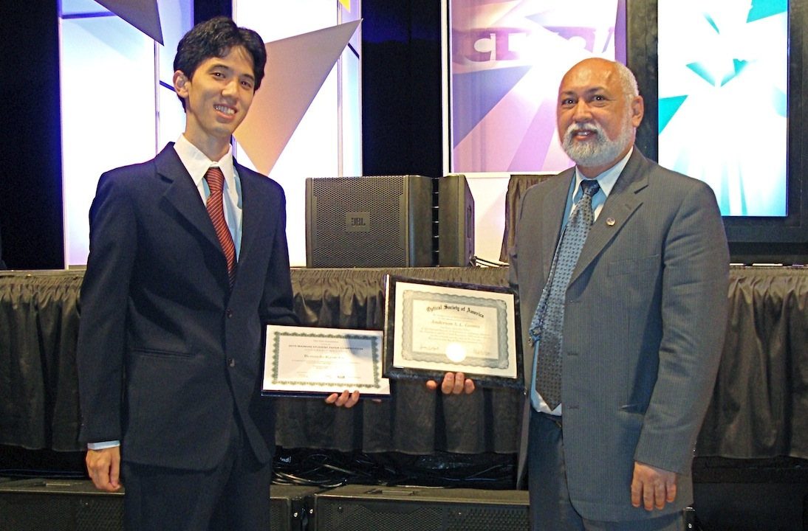



Best 3 student paper in CLEO 2010

Slide 49
Next steps

Slide 50
Summary
Introduced a new on chip spectrometer architecture.
Best on chip spectrometer resolution by a factor of 2.
Drecrease device footprint for the same resolution by a factor of 5.

